Slide 1
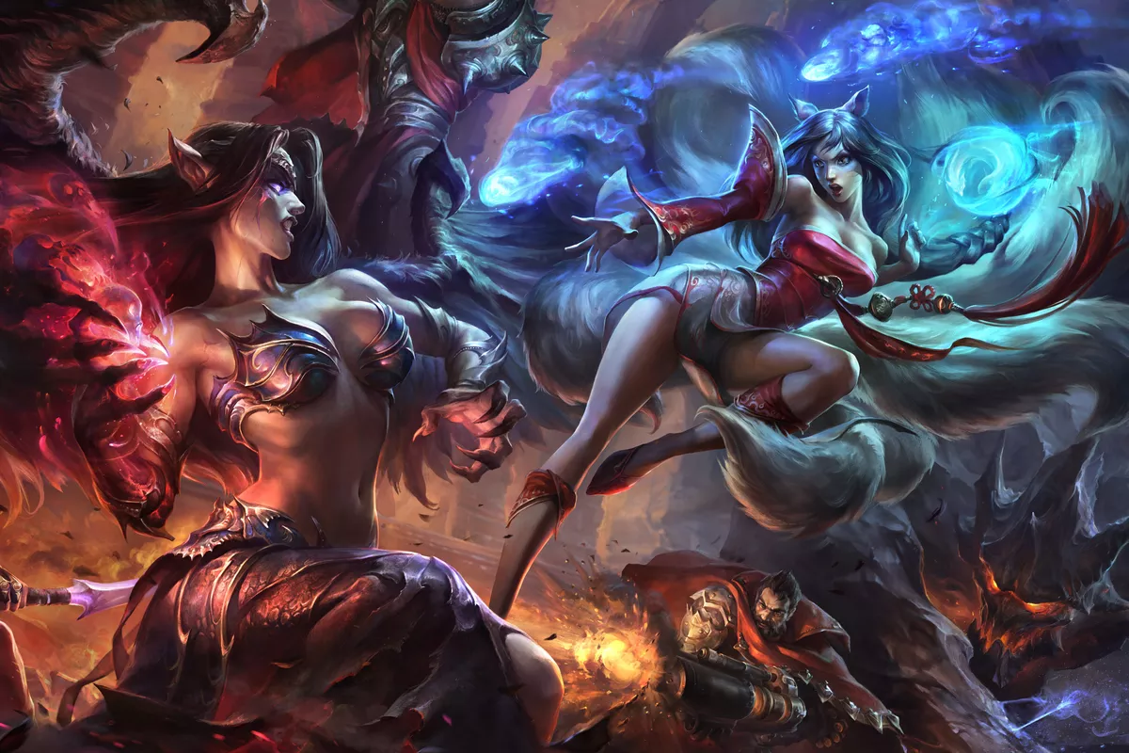


League of legends: The reasons behind the game’s success

Slide 2

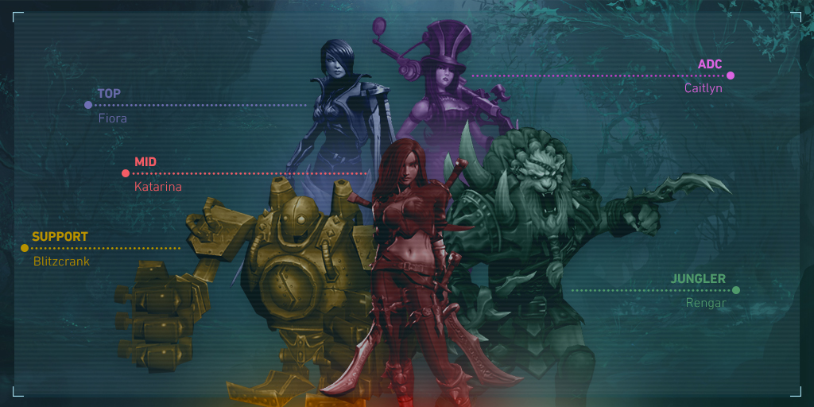
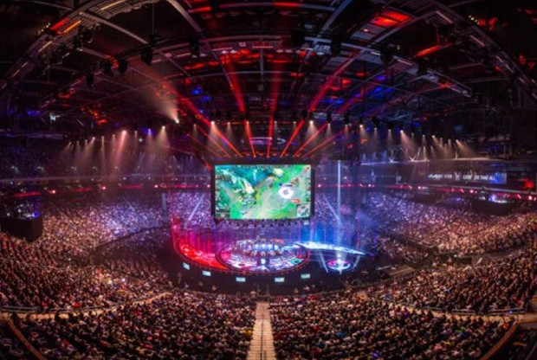
Table of contents
1 Title
2 Table of contents
3 Introduction
Thesis
Argument 1- Accessibility
1.1-Matchmaking
1.2 Pc Specs
1.3 Free-to-Play
Argument 2- Customization
2.1- Choice of Champion
2.2- Choosing how you progress
2.3- Player expression
Argument 3- Digital Marketing
3.1- Esports
3.2- Online Straming
3.3- Social Media
Conclusion
Sources

Slide 3
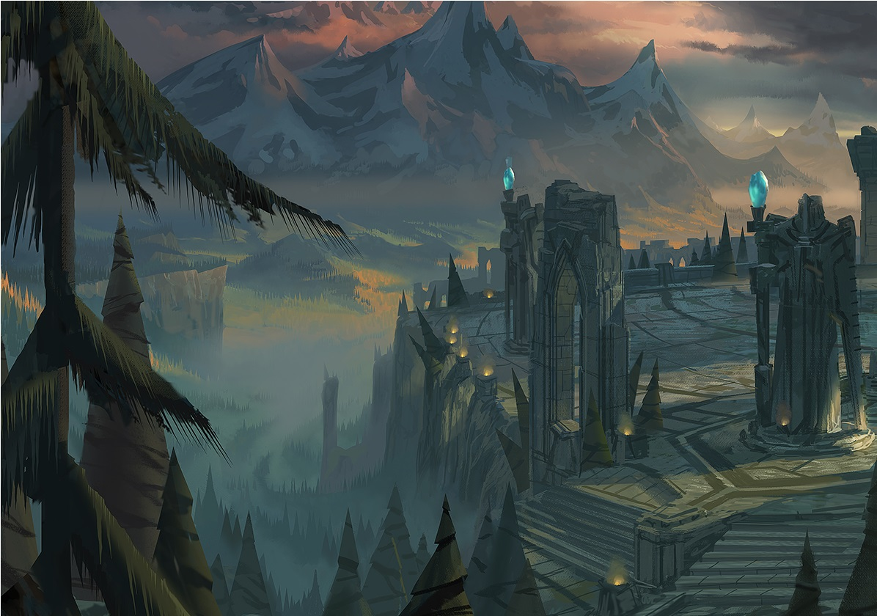
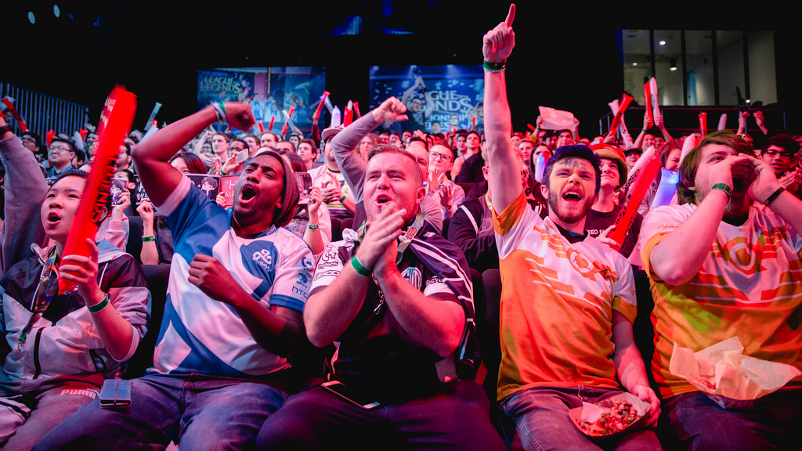
Introduction
League of Legends is the most popular Moba computer game of all time.
Riot games released League of legends in 2009.
League is still the most Popular Moba game, and still one of the most viewed games on twitch, and YouTube till this day.

Slide 4
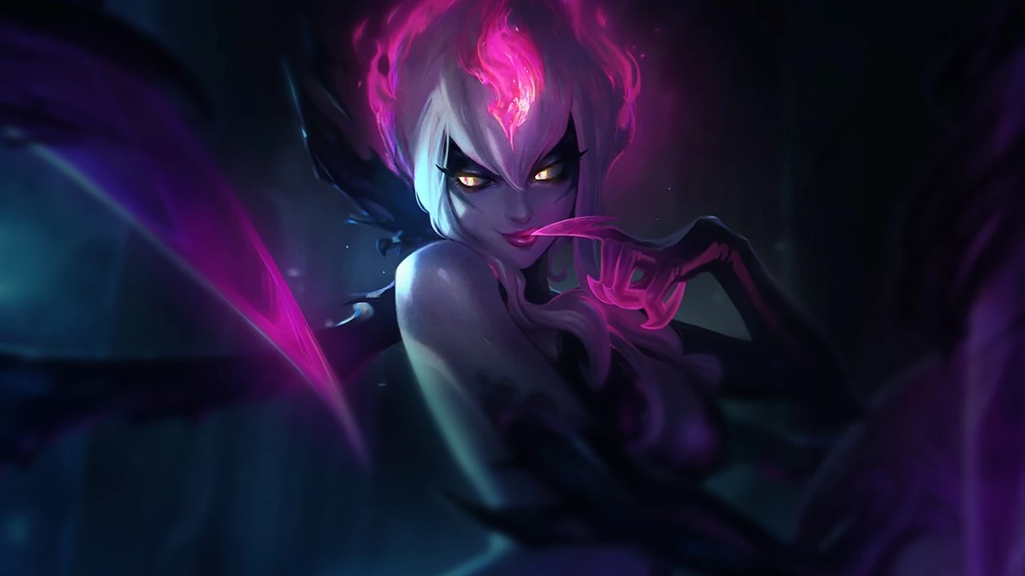
Thesis
Accessibility
Customization
Digital Marketing

Slide 5



Argument 1: Accessibility

Slide 6

Argument 1.1: Matchmaking
Matchmaking is extremely important to find equally skilled opponents to play and challenge yourself against. League of legends has provided a Bots mode for beginners, which they can understand the basics of the game. They have also incorporated a level 1-30 system, meaning once you hit level 30, that is your entry to play the ranked mode. They have plenty of other modes as well, which are all on a spectrum from fun to competitive, so anyone can find enjoyment through a game mode, whether your competitive or not.
League of legends is available to play in any region, making the matchmaking extremely easy, and smooth to find players.
-You can still change which region you wish to play in for multiple reasons such as:
1. To play with friends around the world
2. To play in a more or less competitive environment
3. To conquer ranks in any region

Slide 7

Argument 1.2: Pc Specs
League of legends does not require a lot of specs to run.
(Minimum requirements)
3 GHz single core processor.
2 GB of RAM (4 GB for Windows Vista or newer)
12 GB available hard disk space.
Graphics card with 512MB or higher VRAM and supports DirectX 9.0c.
-This makes it possible to play on an old laptop, and begin your journey without having a gaming pc, or any expensive perks.

Slide 8

Argument 1.3 Free-to-Play
League of Legends is free-to-Play,
The feature attracts majority of the players to sign up with no consequence.
The game does not follow a pay to win system.
More people play if it’s free, which made/makes the game popular and competitive.

Slide 9
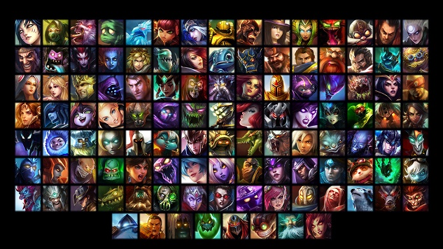
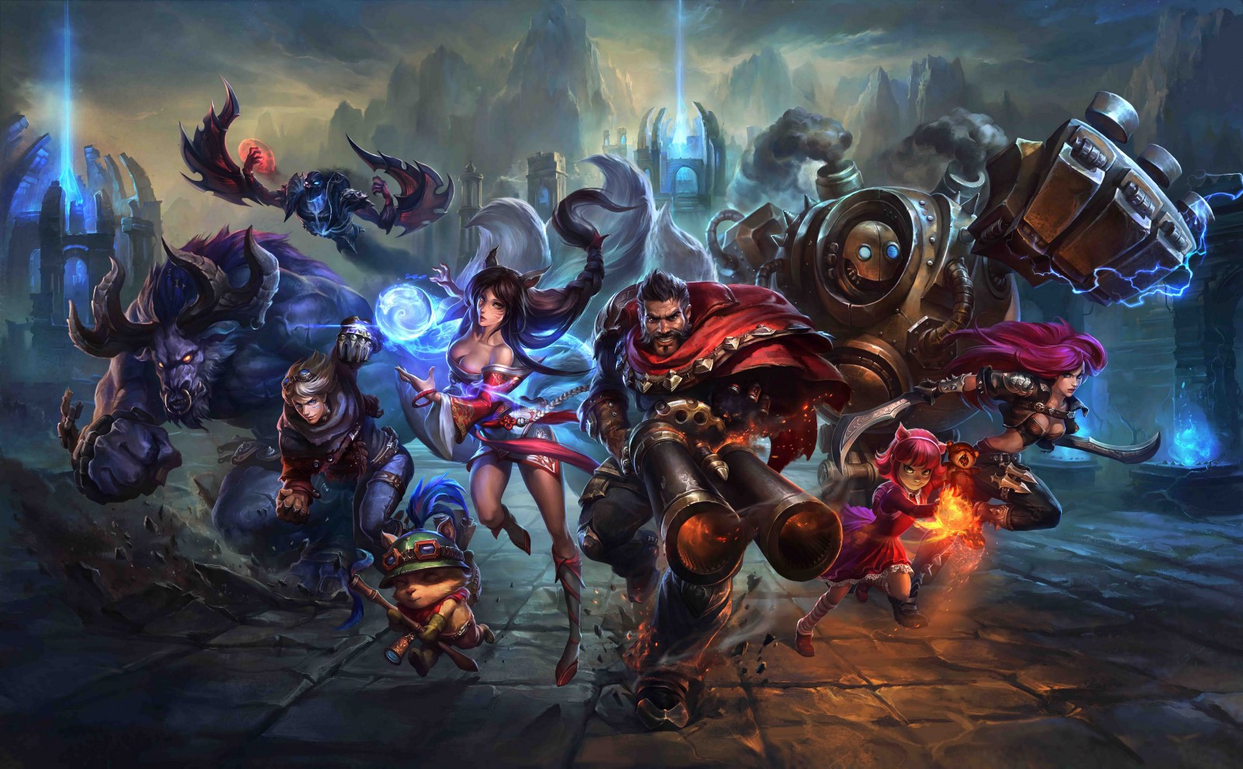

Argument 2: Customization

Slide 10

Argument 2.1: Choice of Champion
There are 142 different champions in League of legends, providing any player to have a more tailored experience.
There are Different types of champions that serve each role. Such as, support, tank, mage, assassin.
The diversity of each champion and the style which you use to play with them makes the game very flexible, diverse and full of opportunity. You get to pick your hero, and play the way you want. If you get bored of that playstyle, there's always a different strategy and champion to win and have fun with.

Slide 11
Argument 2.2: Choosing How you progress
In league of legends there are usually 4 different abilities for each character, And throughout the game you level up from level 1 to 18. Each time you level up you can choose the ability you want to enhance depending on the playstyle you want.
Throughout the game you will also gain gold by defeating other champions or objectives. With gold, you can choose the items you want for your character, which holds the greatest impact on playstyle and strength of your champion. There are hundreds of certain build paths, however, there is usually a few that will work best, and to be able to identify that will improve your chances to outplay opponents and win the game.
League has a lot of diversity in their pathing, whether its item pathing, or pathing where to go on the map for the best result. Every micro or macro play you make will hold value on the outcome and this is what makes the game so engaging, diverse and unique.

Slide 12

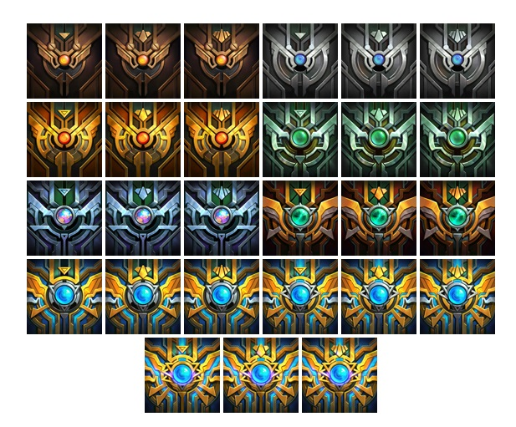
Argument 2.3: Player expression
League of Legends has a lot of features that express the players skill and achievements such as a border system (identifies the rank of player on their border, in the loading screen), Banners (identify the rank of player during que time), and also an Icon of your rank, which you can see in game, and out of game.
Riot also offers multiple skins for each champion, so if you don’t like the look of your favorite champion, or just enjoy aesthetics, skins make the game more flexible to express yourself.

Slide 13
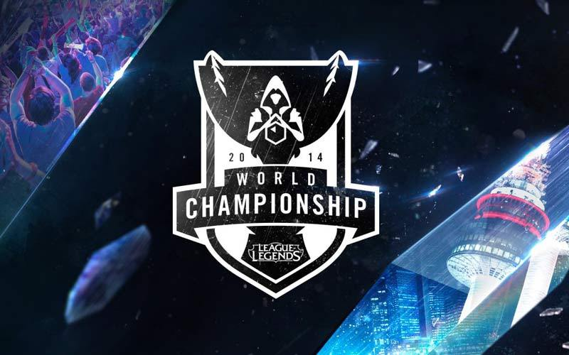


Argument 3- Digital Marketing

Slide 14

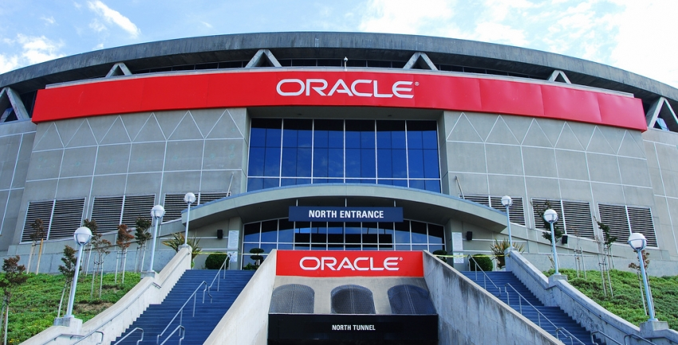
Argument 3.1: eSports
Riot games has held eSports since 2013. The League of legends eSports league is known as the LCS. Seasonal games are watched live at the Oracle Arena, In Oakland, California. However, Riot hosts much more than that, such as the mid season invitational tournament, which includes the best teams from the main regions, and also the Worlds championships which include the best teams from every region. League wiki states “The 2014 World Championship games were streamed live by 40 broadcast partners, and cast in 19 languages. The grand final was watched by 27 million people, with concurrent viewership peaking at over 11 million viewers.” This helps League of legends from an income and popularity standpoint.

Slide 15

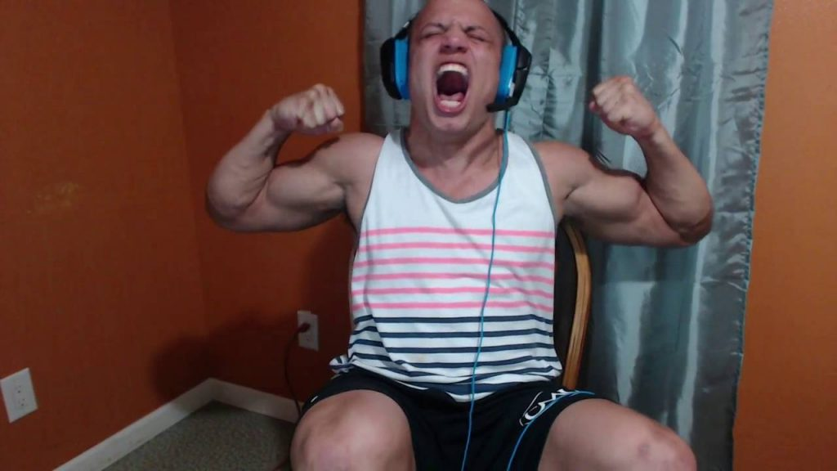
Argument 3.2: Online streaming
League of legends is a very popular video game to stream on, and to make YouTube videos for. Throughout the years, many streamers have gained a lot of attraction while playing this game due to skill, such as the pros, for example, Skt t1 Faker. However, there are some less skillful players who stream for comedy purposes and attract thousands of people, such as Tyler1.
Streamers help with the brand, If you watch a certain streamer due to his/her personality, you also benefit the game they are playing, and Tyler1 does a great job of it.

Slide 16

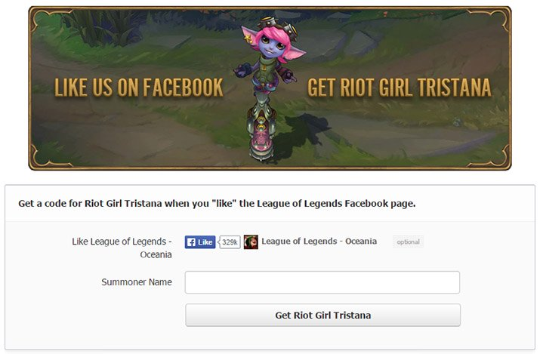
Argument 3.3: Social Media
Riot uses all kinds of social media to post their updates, gameplay and events, to market to their audience. An example being, back in 2015, Riot posted “Like Us On Facebook, Get Riot Girl Tristina”. Events like these benefit the popularity of the game just due to facebook likes.

Slide 17
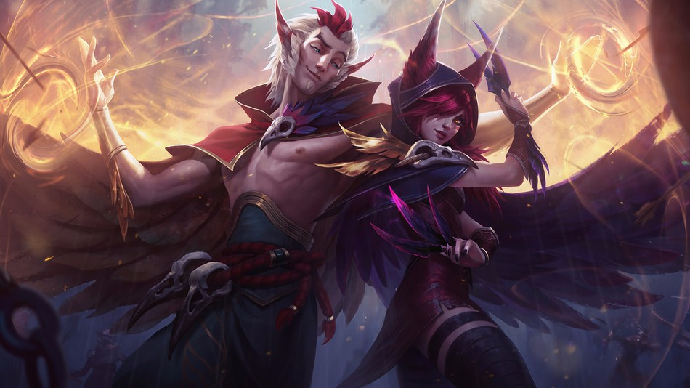
Conclusion
The First reason for Riots success in League of Legends is due to its Accessibility, because its free, easy on specs and the matchmaking makes it possible for anyone from anywhere to play.
Secondly, the Customization, such as the large variety of champions, the unique and engaging progression of the game, and the ability to express yourself and status while you play.
Lastly, Riots Digital Marketing, such as their social media pages that advertise their product, their eSports league which attracts millions, and people who stream their game.
These factors are what has made League of legends a success, and the most popular Moba game in history.

Slide 18
Sources
Xayah Rakan Picture slide 17:
https://www.google.ca/search?rlz=1C1CHBD_enCA825&biw=1920&bih=969&tbm=isch&sa=1&ei=DkUDXJ_DOKewjwTOtqvwBw&q=league+of+legends++champions+waving&oq=league+of+legends++champions+waving&gs_l=img.3...2320.3716..5467...0.0..0.93.940.12......1....1..gws-wiz-img.......0i8i30.uNddEAxRtOQ#imgrc=HN-Y40rUjmdBjM:
Tyler 1 picture, slide 15
https://www.google.ca/search?rlz=1C1CHBD_enCA825&biw=1920&bih=920&tbm=isch&sa=1&ei=vT0DXI_PB8rGjwSquYOIAQ&q=tyler1&oq=tyler1&gs_l=img.3..0l10.1421166.1421940..1422051...0.0..0.86.476.6......1....1..gws-wiz-img.....0..35i39j0i67.A5tioMUUVUA#imgrc=QpA7PBff6VuGKM:
Tristina picture slide 16:
https://boosteria.org/guides/league-legends-free-skins-guide-unlock
Paths picture, slide 9
https://www.google.ca/search?rlz=1C1CHBD_enCA825&biw=1920&bih=920&tbm=isch&sa=1&ei=rj0DXIaiCYeHjwTMp7WAAw&q=CHOOSING+PATHS&oq=CHOOSING+PATHS&gs_l=img.3..0l2j0i8i30l3.10576.13901..14012...1.0..2.98.1730.21......2....1..gws-wiz-img.....0..0i67j35i39.MVSlNej44nQ#imgrc=sc8UD10ZmXpgoM:
Globe, slide 5
https://www.google.ca/search?rlz=1C1CHBD_enCA825&biw=1920&bih=920&tbm=isch&sa=1&ei=RTgDXJmmN466jwTnhJfoAQ&q=GLOBAL&oq=GLOBAL&gs_l=img.3..0j0i67l3j0l6.70074.70896..71111...0.0..0.83.475.6......1....1..gws-wiz-img.....0..35i39.DsUPhq9hgYk#imgrc=LMNmRy3da6AN-M:
Free2play, Slide 5
https://www.google.ca/search?rlz=1C1CHBD_enCA825&biw=1920&bih=920&tbm=isch&sa=1&ei=QjgDXPO3CObHjwSd_L9I&q=FREE+TO+PLAY&oq=FREE+TO+PLAY&gs_l=img.3..0l10.1208.2261..2661...0.0..0.90.251.3......1....1..gws-wiz-img.......0i10i24.BsWxq6f_ZLY#imgrc=5JbtO9JokapLbM:

Slide 19
Sources
Oracle arena, slide 14
https://www.google.ca/search?rlz=1C1CHBD_enCA825&biw=1920&bih=969&tbm=isch&sa=1&ei=lEMDXP75AYjSjwSRgr6QBw&q=oakland+lcs&oq=oakland+lcs&gs_l=img.3..0i24.4462.5822..6012...0.0..0.129.907.10j1......1....1..gws-wiz-img.....0..0j35i39j0i67.az4Mq0-RxHc#imgrc=s92dHd5vDq7_AM:
eSports picture, slide 2
https://www.google.ca/search?rlz=1C1CHBD_enCA825&biw=1920&bih=969&tbm=isch&sa=1&ei=lkEDXNTrIpCgjwSe_Im4CQ&q=esports+&oq=esports+&gs_l=img.3..0l10.294113.295037..295269...0.0..0.108.657.7j1......1....1..gws-wiz-img.....0..35i39j0i67.7O-J7xVNK1M#imgrc=yYBaKVyfczS9AM:
Social media, slide 13
https://www.google.ca/search?rlz=1C1CHBD_enCA825&biw=1920&bih=969&tbm=isch&sa=1&ei=cUEDXJ3hB66cjgTH4oHACA&q=social+media&oq=social+media&gs_l=img.3..0i67j0j0i67l4j0j0i67l3.34433.36491..36599...1.0..0.86.1023.13......1....1..gws-wiz-img.....0..35i39.JNbxxs6MQGg#imgrc=nMyd0E7CnmjQtM:
Twitch logo, slide, 13
https://www.google.ca/search?rlz=1C1CHBD_enCA825&biw=1920&bih=969&tbm=isch&sa=1&ei=UEEDXNqbKtLTjgSApL3oCQ&q=twitch.tv&oq=twitch.tv&gs_l=img.3..0l10.28527.31095..31547...1.0..0.95.806.10......1....1..gws-wiz-img.....0..35i39j0i67.hC0yS5i79rM#imgrc=UdoDou8f4RxdeM:
Worlds invitational picture, slide 13
https://www.google.ca/search?rlz=1C1CHBD_enCA825&biw=1920&bih=969&tbm=isch&sa=1&ei=9UADXLL-LrPBjgTOwKqQDA&q=riot+games+martketing&oq=riot+games+martketing&gs_l=img.3...572.5239..5338...0.0..0.142.1395.16j1......1....1..gws-wiz-img.......0j35i39j0i67j0i8i30j0i24.K2eFiHAkTB4#imgrc=D1eqOUUV37I-yM:

Slide 20
Sources
Rank borders, slide 12
https://www.google.ca/search?rlz=1C1CHBD_enCA825&biw=1920&bih=969&tbm=isch&sa=1&ei=JD0DXPhPqc6PBOThpsgK&q=rANKED+BORDERS+LOL&oq=rANKED+BORDERS+LOL&gs_l=img.3..0j0i5i30l2j0i8i30l3.31130.803578..803778...17.0..3.236.3271.34j2j1......10....1..gws-wiz-img.....0..35i39j0i67j0i30j0i24.ADol7-L25hY#imgrc=56X0EumbeeKCzM:
Champions, slide 9
https://www.google.ca/search?rlz=1C1CHBD_enCA825&biw=1920&bih=969&tbm=isch&sa=1&ei=4TcDXIiPK4rMjwTHhLr4Cg&q=CHAMPIONS+IN+LEAGUE+OF+OLEGENDS&oq=CHAMPIONS+IN+LEAGUE+OF+OLEGENDS&gs_l=img.3...611664.1345329..1345446...0.0..3.164.2580.29j2......8....1..gws-wiz-img.....0..0j0i67j35i39j0i8i30j0i24j0i5i30j0i30.jPfNOAC1a5I#imgrc=yYQmnrkFl0TAWM:
Laptop
https://www.google.ca/search?rlz=1C1CHBD_enCA825&biw=1920&bih=969&tbm=isch&sa=1&ei=zzcDXKjeDorNjwS5kbXQAw&q=CHEAP+LAPTOP&oq=CHEAP+LAPTOP&gs_l=img.3..35i39l2j0l8.15419.17264..17464...0.0..0.100.1036.10j2......1....1..gws-wiz-img.....0..0i67.1LPcGf0yWG0#imgrc=i5HB2DdBQtE-2M:
Champions
https://www.google.ca/search?rlz=1C1CHBD_enCA825&biw=1920&bih=969&tbm=isch&sa=1&ei=qzcDXO3cE8r4jwS2wZPgCQ&q=Lol+champs&oq=Lol+champs&gs_l=img.3..0l2j0i5i30l7j0i8i30.31554.34890..35010...0.0..3.135.3435.30j8......2....1..gws-wiz-img.....0..35i39j0i67.0iHBFZg_rac#imgrc=xN5G0OYC85aWmM:

